Slide 1
COMPARING BIG CITIES

Slide 2
ESSENTIAL INFORMATION ABOUT CITIES IS VALUABLE FOR INVESTORS AND INTERESTED PEOPLE
In order to open new venues we need to have a sense of the most popular ones.
If one venue is successful in one city, it might be successful in another similar city.
It is necessary to open a new venue in a place where it is not crowded

Slide 3
Data acquisition and cleaning
I had some really hard problems trying to get the data from Neighborhoods.
For California neighborhoods:
https://www.geonames.org/postal-codes/US/CA/california.html
For Toronto neighborhoods:
https://en.wikipedia.org/wiki/List_of_postal_codes_of_Canada:_M
For Manhattan neighborhoods:
https://cocl.us/new_york_dataset
To get the coordinates I used the Arcgis method

Slide 4
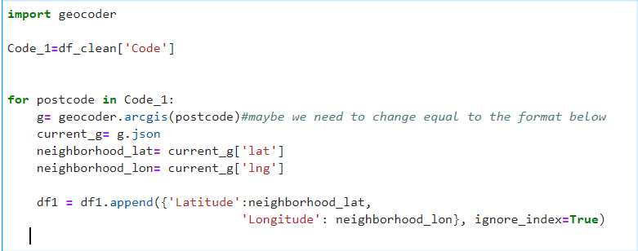
Usign the arcgis method

Slide 5

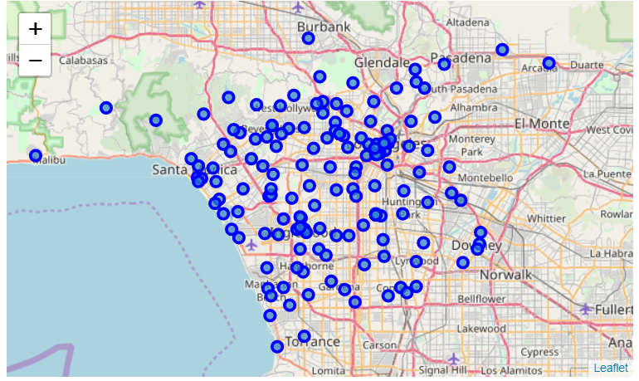
California

Slide 6
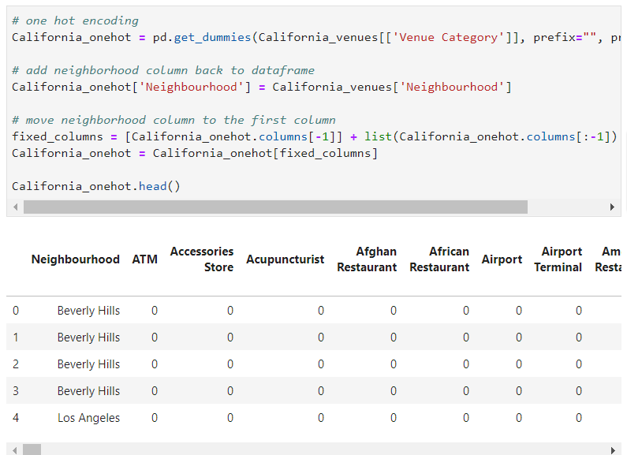
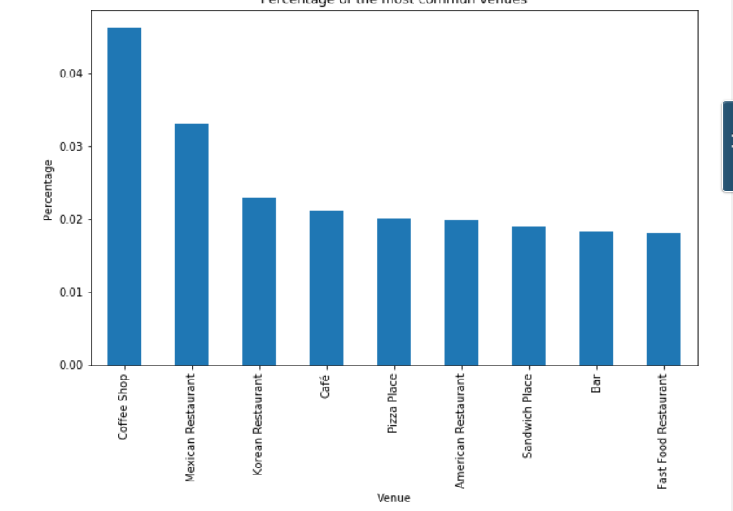
Using one hot encoding for California venues
Most popular venues in California

Slide 7

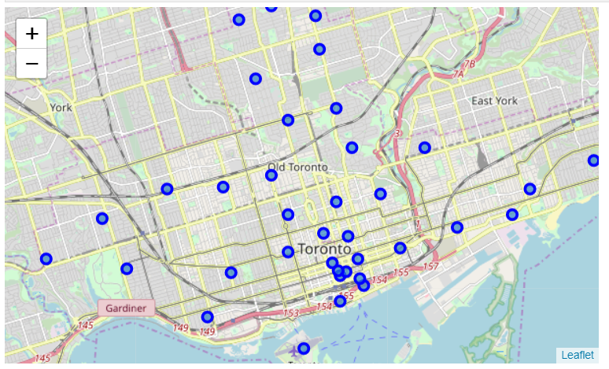
Toronto

Slide 8
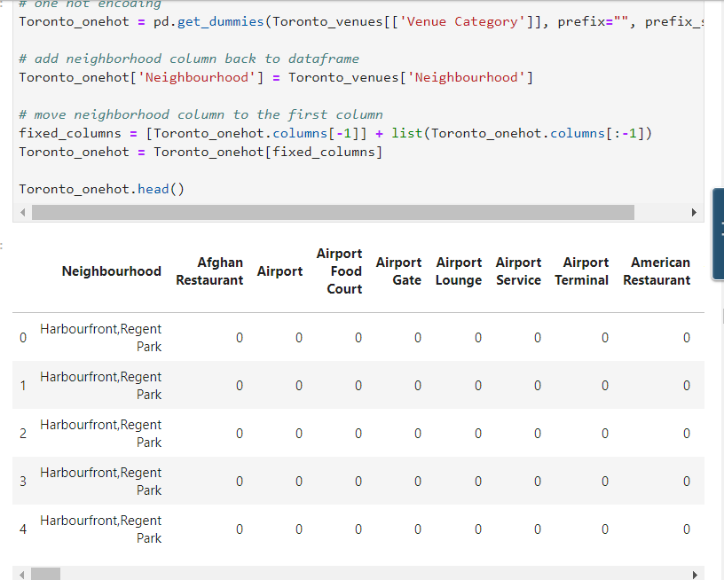
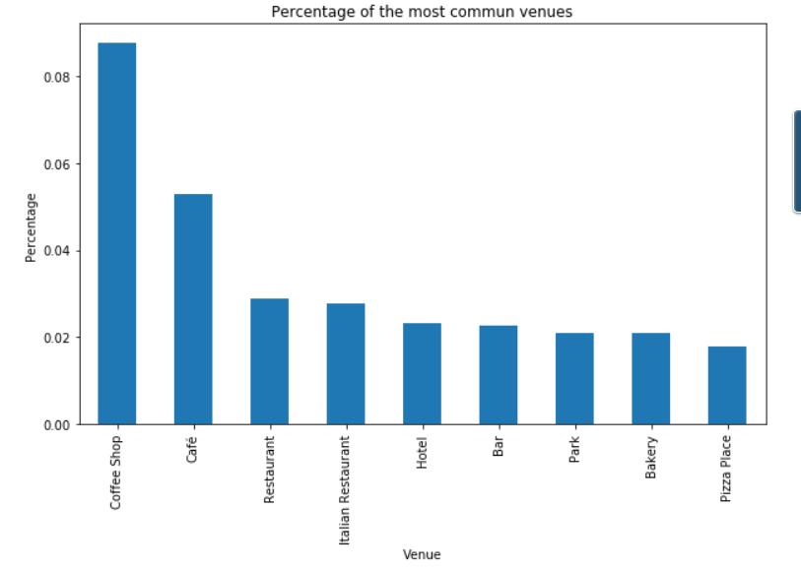
Using one hot encoding for Toronto venues
Most popular venues in Toronto

Slide 9

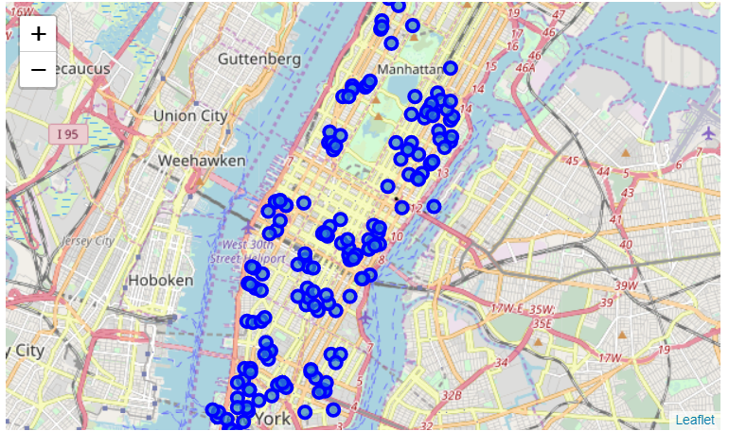
Manhattan

Slide 10
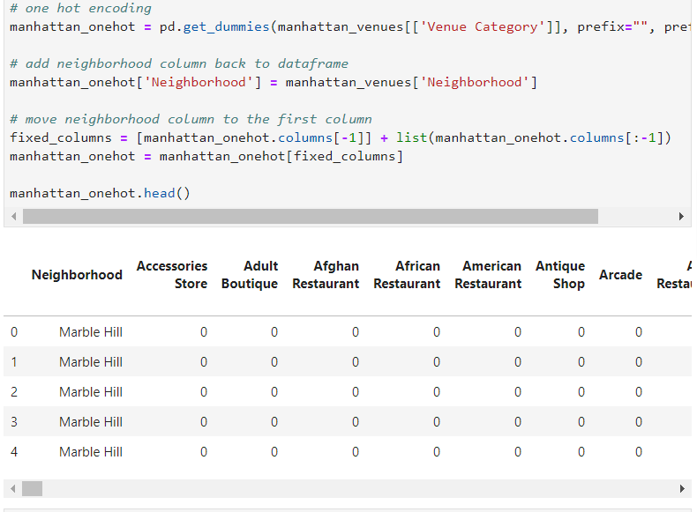
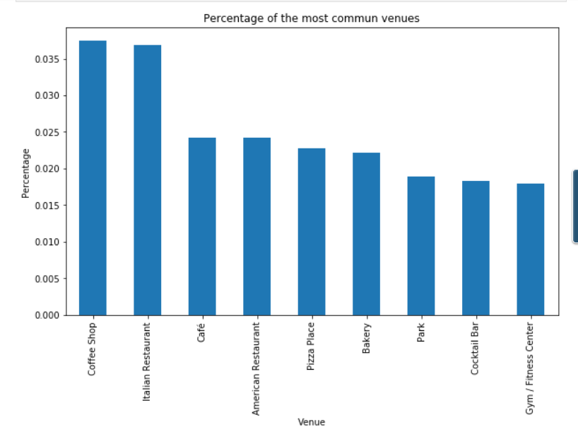
Using one hot encoding for Manhattan venues
Most popular venues in Manhattan

Slide 11
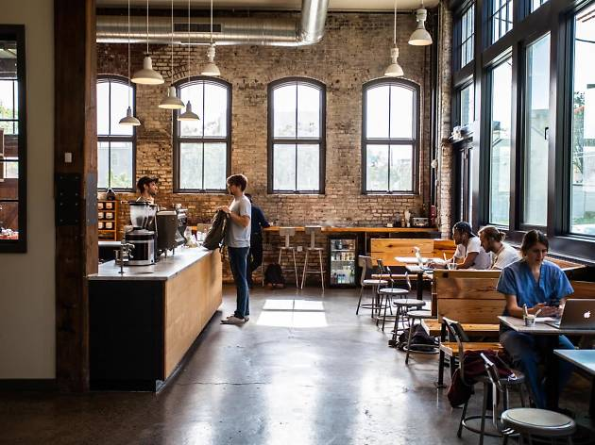
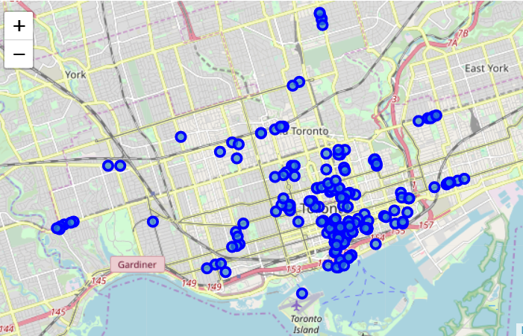
Most popular venue
Coffee Shops
Only Coffee Shops in Toronto

Slide 12
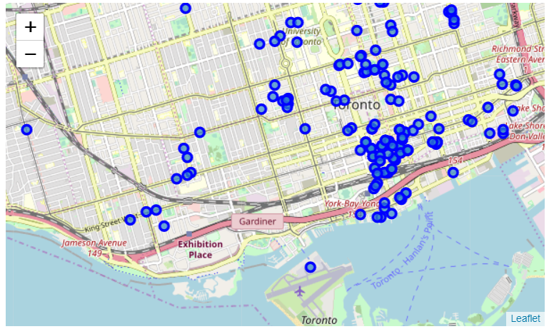
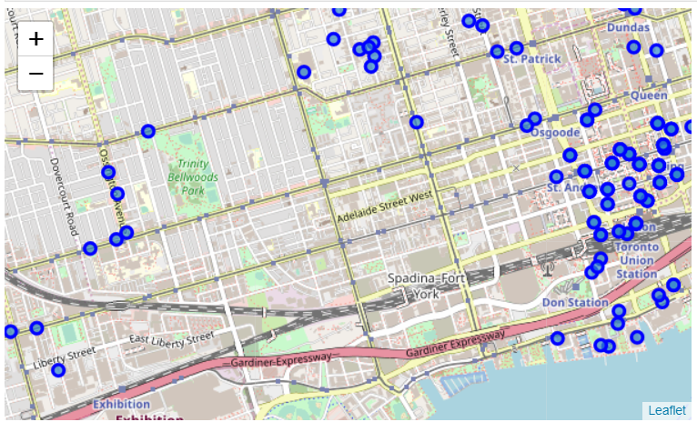
Downtown is crowded with coffee shops
Near Spadina Fort York would be a good place to open a coffee shop

Slide 13
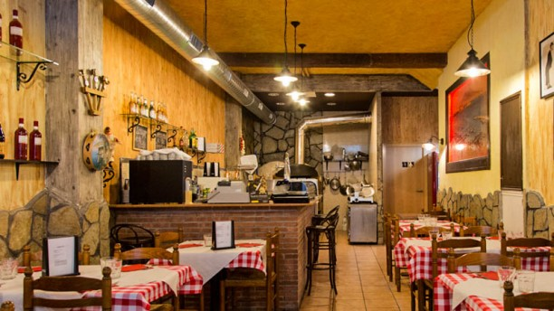
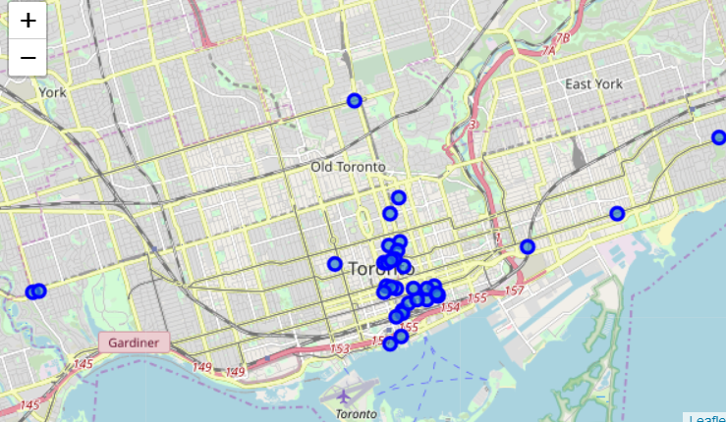
Pizza place
It might be a good idea to open a Pizza place in Toronto
Pizza Places in Toronto

Slide 14
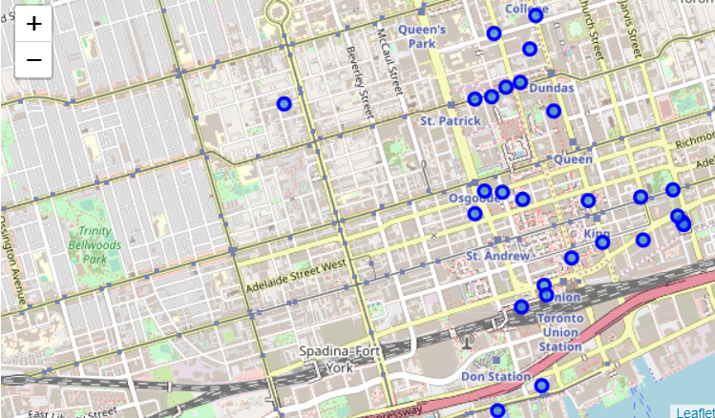
Near spadina fort York is again a convenient place to open a new venue

Slide 15
conclusion
The model gave some useful data from the cities and showed a map with their locations
We built a relatively simple model that will help us to choose the most profitable venue.
It also suggests some places where it would be adequate to open a venue.
There is plenty of room for improvent, specially in the complexity of algorithms, but I used what they taught us stricly.

